Slide 1

Harry
https://en.wikipedia.org/wiki/Thread_(computing)
PPT模板下载：www.1ppt.com/moban/ 行业PPT模板：www.1ppt.com/hangye/
节日PPT模板：www.1ppt.com/jieri/ PPT素材下载：www.1ppt.com/sucai/
PPT背景图片：www.1ppt.com/beijing/ PPT图表下载：www.1ppt.com/tubiao/
优秀PPT下载：www.1ppt.com/xiazai/ PPT教程： www.1ppt.com/powerpoint/
Word教程： www.1ppt.com/word/ Excel教程：www.1ppt.com/excel/
资料下载：www.1ppt.com/ziliao/ PPT课件下载：www.1ppt.com/kejian/
范文下载：www.1ppt.com/fanwen/ 试卷下载：www.1ppt.com/shiti/
教案下载：www.1ppt.com/jiaoan/ PPT论坛：www.1ppt.cn

Slide 2
What is a Thread?
Almost every operating system supports independently running programs called processes. Threading is a facility to allow multiple activities to coexist within a single process. Java is the first programming language to explicitly include threading within the language itself, rather than treating it as a facility of the underlying OS.
Threads are sometimes called as lightweight processes. Like processes,they work independently and each thread has its own stack, program counter, and local variables. Even though they have their own stuff, threads within a process are less insulated from each other than separate processes are. They share memory space, file handles, etc. This means they have access to the same variables and objects. While this makes it easier for them to share information, the programmer must be very careful not to let them interfere with each other in the same process.
PPT模板下载：www.1ppt.com/moban/ 行业PPT模板：www.1ppt.com/hangye/
节日PPT模板：www.1ppt.com/jieri/ PPT素材下载：www.1ppt.com/sucai/
PPT背景图片：www.1ppt.com/beijing/ PPT图表下载：www.1ppt.com/tubiao/
优秀PPT下载：www.1ppt.com/xiazai/ PPT教程： www.1ppt.com/powerpoint/
Word教程： www.1ppt.com/word/ Excel教程：www.1ppt.com/excel/
资料下载：www.1ppt.com/ziliao/ PPT课件下载：www.1ppt.com/kejian/
范文下载：www.1ppt.com/fanwen/ 试卷下载：www.1ppt.com/shiti/
教案下载：www.1ppt.com/jiaoan/ PPT论坛：www.1ppt.cn

Slide 3
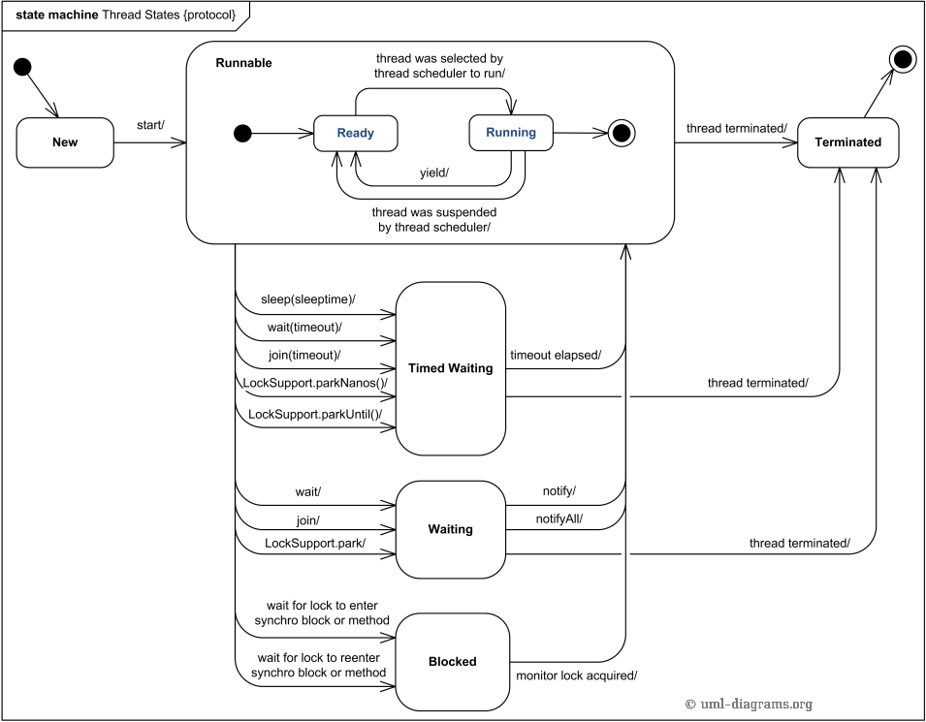
Thread States And Switching
PPT模板下载：www.1ppt.com/moban/ 行业PPT模板：www.1ppt.com/hangye/
节日PPT模板：www.1ppt.com/jieri/ PPT素材下载：www.1ppt.com/sucai/
PPT背景图片：www.1ppt.com/beijing/ PPT图表下载：www.1ppt.com/tubiao/
优秀PPT下载：www.1ppt.com/xiazai/ PPT教程： www.1ppt.com/powerpoint/
Word教程： www.1ppt.com/word/ Excel教程：www.1ppt.com/excel/
资料下载：www.1ppt.com/ziliao/ PPT课件下载：www.1ppt.com/kejian/
范文下载：www.1ppt.com/fanwen/ 试卷下载：www.1ppt.com/shiti/
教案下载：www.1ppt.com/jiaoan/ PPT论坛：www.1ppt.cn

Slide 4
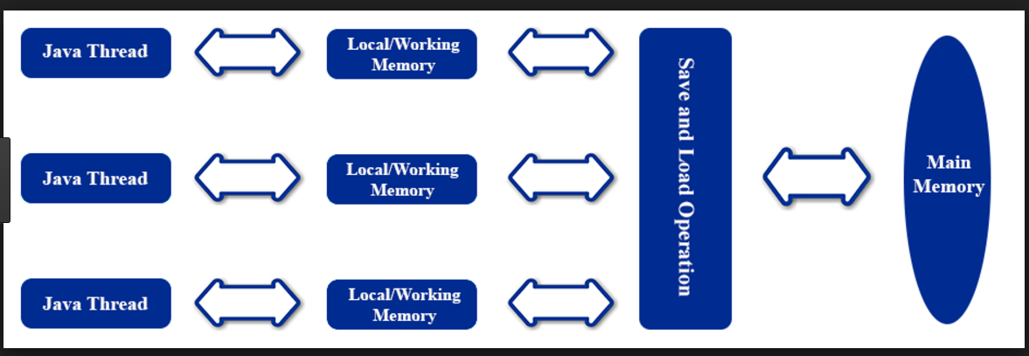
Java Thread Memory Model
PPT模板下载：www.1ppt.com/moban/ 行业PPT模板：www.1ppt.com/hangye/
节日PPT模板：www.1ppt.com/jieri/ PPT素材下载：www.1ppt.com/sucai/
PPT背景图片：www.1ppt.com/beijing/ PPT图表下载：www.1ppt.com/tubiao/
优秀PPT下载：www.1ppt.com/xiazai/ PPT教程： www.1ppt.com/powerpoint/
Word教程： www.1ppt.com/word/ Excel教程：www.1ppt.com/excel/
资料下载：www.1ppt.com/ziliao/ PPT课件下载：www.1ppt.com/kejian/
范文下载：www.1ppt.com/fanwen/ 试卷下载：www.1ppt.com/shiti/
教案下载：www.1ppt.com/jiaoan/ PPT论坛：www.1ppt.cn

Slide 5
Operations Between Working Memory And Main Memory
lock
unlock
read
load
use
assign
store
write
（lock - unlock） lock将一个主内存变量标记成线程独占，unlock将独占的变量释放
（read - load）read 将主内存的变量读取到CPU中，load操作将read到的变量存入到工作内存中,一定会成对出现
（use - assign） use将工作内存中的变量传递给执行的代码中，当代码需要使用变量值的字节码时，需要这个操作。 assign 赋值操作，将代码中赋值指令出现时，把收到的变量赋值到工作内存中
(store - write) store 将工作内存的变量传送回主内存，但是只是传送，write操作才会将值写入到主内存。而且这两个一定会成对出现
PPT模板下载：www.1ppt.com/moban/ 行业PPT模板：www.1ppt.com/hangye/
节日PPT模板：www.1ppt.com/jieri/ PPT素材下载：www.1ppt.com/sucai/
PPT背景图片：www.1ppt.com/beijing/ PPT图表下载：www.1ppt.com/tubiao/
优秀PPT下载：www.1ppt.com/xiazai/ PPT教程： www.1ppt.com/powerpoint/
Word教程： www.1ppt.com/word/ Excel教程：www.1ppt.com/excel/
资料下载：www.1ppt.com/ziliao/ PPT课件下载：www.1ppt.com/kejian/
范文下载：www.1ppt.com/fanwen/ 试卷下载：www.1ppt.com/shiti/
教案下载：www.1ppt.com/jiaoan/ PPT论坛：www.1ppt.cn

Slide 6
Illustrate
read load ; store write只能成对操作，不能出现只读不用，只返回不存储
不允许线程丢弃assign操作，用完的变量一定会传回主内存，也不允许将未assign的变量从工作内存写回主内存
变量只能从主内存中创建，未初始化的变量线程不能load 或 assign
变量只能被一条线程lock，而且可以lock很多次，必须执行相应条数的unlock才会被释放
线程只能unlock自己lock的变量，未被lock的变量不能执行unlock，不允许unlock其他线程lock的变量
lock变量操作会将工作内存的变量清空，使用这个变量时，相应使用这个变量时，需要重新load 和assign
unlock 前，变量会被重新写入主内存
PPT模板下载：www.1ppt.com/moban/ 行业PPT模板：www.1ppt.com/hangye/
节日PPT模板：www.1ppt.com/jieri/ PPT素材下载：www.1ppt.com/sucai/
PPT背景图片：www.1ppt.com/beijing/ PPT图表下载：www.1ppt.com/tubiao/
优秀PPT下载：www.1ppt.com/xiazai/ PPT教程： www.1ppt.com/powerpoint/
Word教程： www.1ppt.com/word/ Excel教程：www.1ppt.com/excel/
资料下载：www.1ppt.com/ziliao/ PPT课件下载：www.1ppt.com/kejian/
范文下载：www.1ppt.com/fanwen/ 试卷下载：www.1ppt.com/shiti/
教案下载：www.1ppt.com/jiaoan/ PPT论坛：www.1ppt.cn

Slide 7
Happens-before Rules
http://www.logicbig.com/tutorials/core-java-tutorial/java-multi-threading/happens-before/
PPT模板下载：www.1ppt.com/moban/ 行业PPT模板：www.1ppt.com/hangye/
节日PPT模板：www.1ppt.com/jieri/ PPT素材下载：www.1ppt.com/sucai/
PPT背景图片：www.1ppt.com/beijing/ PPT图表下载：www.1ppt.com/tubiao/
优秀PPT下载：www.1ppt.com/xiazai/ PPT教程： www.1ppt.com/powerpoint/
Word教程： www.1ppt.com/word/ Excel教程：www.1ppt.com/excel/
资料下载：www.1ppt.com/ziliao/ PPT课件下载：www.1ppt.com/kejian/
范文下载：www.1ppt.com/fanwen/ 试卷下载：www.1ppt.com/shiti/
教案下载：www.1ppt.com/jiaoan/ PPT论坛：www.1ppt.cn

Slide 8
Volatile VS Synchronized
http://www.logicbig.com/tutorials/core-java-tutorial/java-multi-threading/happens-before/
PPT模板下载：www.1ppt.com/moban/ 行业PPT模板：www.1ppt.com/hangye/
节日PPT模板：www.1ppt.com/jieri/ PPT素材下载：www.1ppt.com/sucai/
PPT背景图片：www.1ppt.com/beijing/ PPT图表下载：www.1ppt.com/tubiao/
优秀PPT下载：www.1ppt.com/xiazai/ PPT教程： www.1ppt.com/powerpoint/
Word教程： www.1ppt.com/word/ Excel教程：www.1ppt.com/excel/
资料下载：www.1ppt.com/ziliao/ PPT课件下载：www.1ppt.com/kejian/
范文下载：www.1ppt.com/fanwen/ 试卷下载：www.1ppt.com/shiti/
教案下载：www.1ppt.com/jiaoan/ PPT论坛：www.1ppt.cn

Slide 9
Netty Architecture
PPT模板下载：www.1ppt.com/moban/ 行业PPT模板：www.1ppt.com/hangye/
节日PPT模板：www.1ppt.com/jieri/ PPT素材下载：www.1ppt.com/sucai/
PPT背景图片：www.1ppt.com/beijing/ PPT图表下载：www.1ppt.com/tubiao/
优秀PPT下载：www.1ppt.com/xiazai/ PPT教程： www.1ppt.com/powerpoint/
Word教程： www.1ppt.com/word/ Excel教程：www.1ppt.com/excel/
资料下载：www.1ppt.com/ziliao/ PPT课件下载：www.1ppt.com/kejian/
范文下载：www.1ppt.com/fanwen/ 试卷下载：www.1ppt.com/shiti/
教案下载：www.1ppt.com/jiaoan/ PPT论坛：www.1ppt.cn

Slide 10

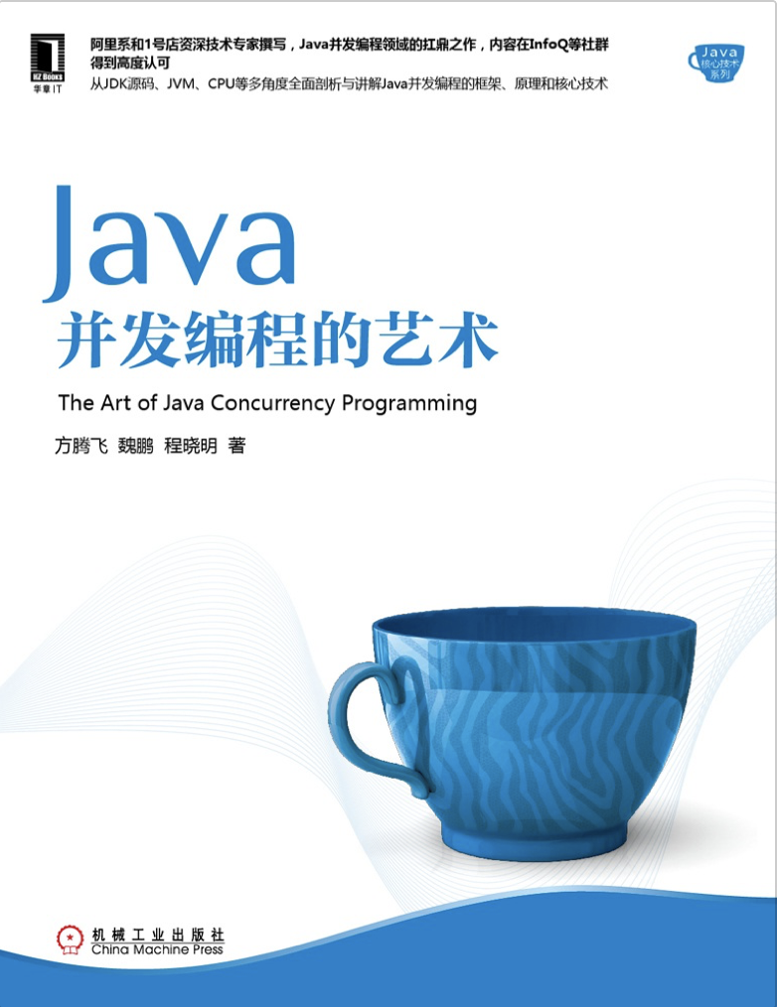
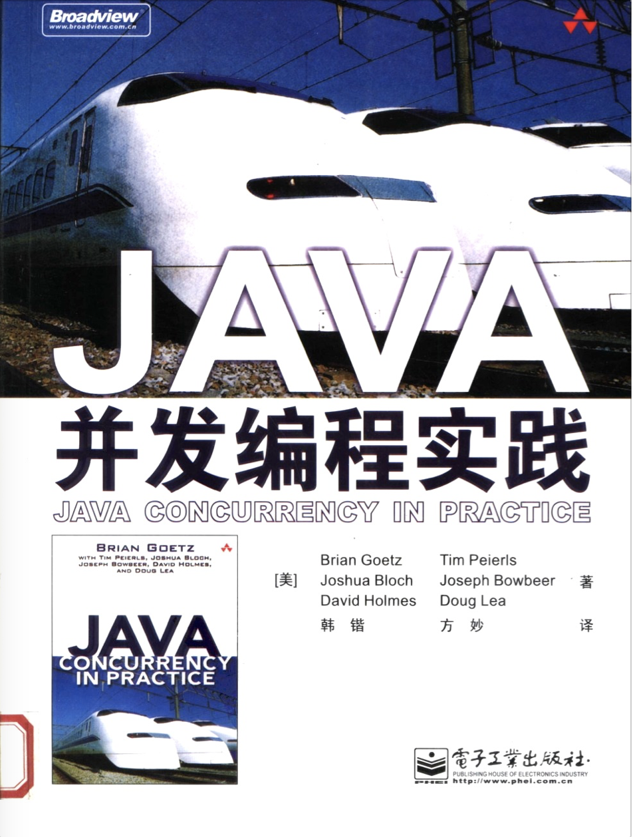
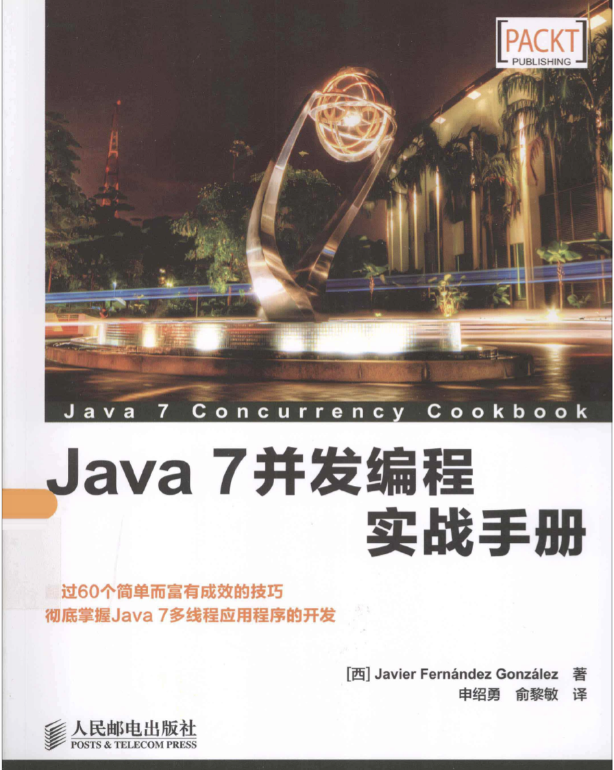
推荐书籍（1）
PPT模板下载：www.1ppt.com/moban/ 行业PPT模板：www.1ppt.com/hangye/
节日PPT模板：www.1ppt.com/jieri/ PPT素材下载：www.1ppt.com/sucai/
PPT背景图片：www.1ppt.com/beijing/ PPT图表下载：www.1ppt.com/tubiao/
优秀PPT下载：www.1ppt.com/xiazai/ PPT教程： www.1ppt.com/powerpoint/
Word教程： www.1ppt.com/word/ Excel教程：www.1ppt.com/excel/
资料下载：www.1ppt.com/ziliao/ PPT课件下载：www.1ppt.com/kejian/
范文下载：www.1ppt.com/fanwen/ 试卷下载：www.1ppt.com/shiti/
教案下载：www.1ppt.com/jiaoan/ PPT论坛：www.1ppt.cn

Slide 11
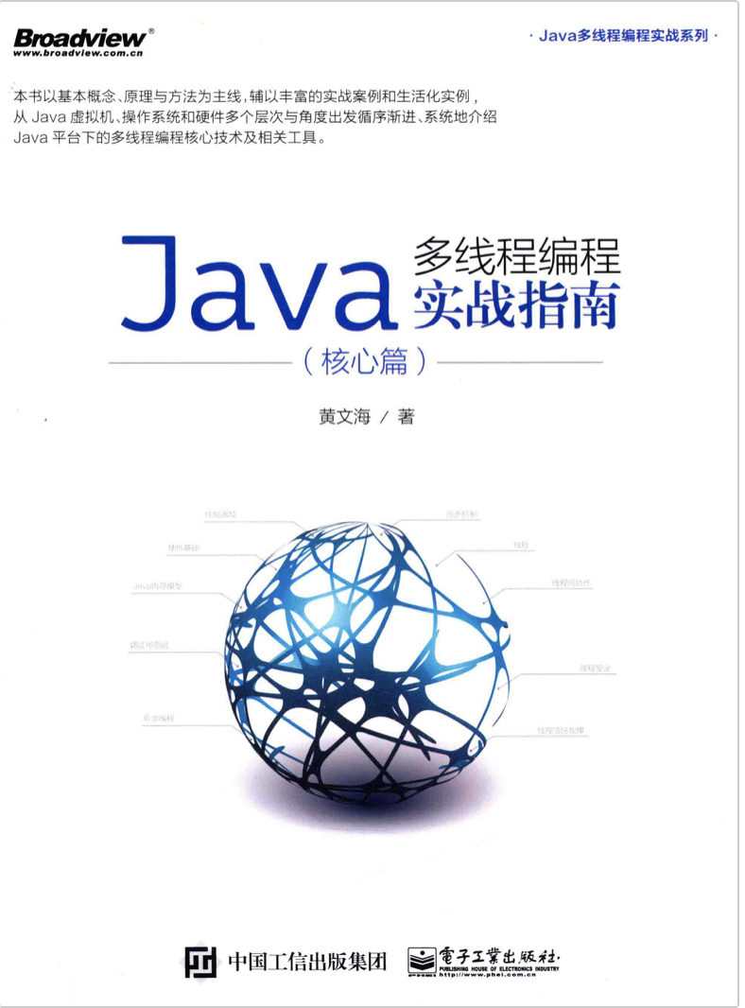

推荐书籍（2）
PPT模板下载：www.1ppt.com/moban/ 行业PPT模板：www.1ppt.com/hangye/
节日PPT模板：www.1ppt.com/jieri/ PPT素材下载：www.1ppt.com/sucai/
PPT背景图片：www.1ppt.com/beijing/ PPT图表下载：www.1ppt.com/tubiao/
优秀PPT下载：www.1ppt.com/xiazai/ PPT教程： www.1ppt.com/powerpoint/
Word教程： www.1ppt.com/word/ Excel教程：www.1ppt.com/excel/
资料下载：www.1ppt.com/ziliao/ PPT课件下载：www.1ppt.com/kejian/
范文下载：www.1ppt.com/fanwen/ 试卷下载：www.1ppt.com/shiti/
教案下载：www.1ppt.com/jiaoan/ PPT论坛：www.1ppt.cn

Slide 12

PPT模板下载：www.1ppt.com/moban/ 行业PPT模板：www.1ppt.com/hangye/
节日PPT模板：www.1ppt.com/jieri/ PPT素材下载：www.1ppt.com/sucai/
PPT背景图片：www.1ppt.com/beijing/ PPT图表下载：www.1ppt.com/tubiao/
优秀PPT下载：www.1ppt.com/xiazai/ PPT教程： www.1ppt.com/powerpoint/
Word教程： www.1ppt.com/word/ Excel教程：www.1ppt.com/excel/
资料下载：www.1ppt.com/ziliao/ PPT课件下载：www.1ppt.com/kejian/
范文下载：www.1ppt.com/fanwen/ 试卷下载：www.1ppt.com/shiti/
教案下载：www.1ppt.com/jiaoan/ PPT论坛：www.1ppt.cn

Slide 13

PPT模板下载：www.1ppt.com/moban/ 行业PPT模板：www.1ppt.com/hangye/
节日PPT模板：www.1ppt.com/jieri/ PPT素材下载：www.1ppt.com/sucai/
PPT背景图片：www.1ppt.com/beijing/ PPT图表下载：www.1ppt.com/tubiao/
优秀PPT下载：www.1ppt.com/xiazai/ PPT教程： www.1ppt.com/powerpoint/
Word教程： www.1ppt.com/word/ Excel教程：www.1ppt.com/excel/
资料下载：www.1ppt.com/ziliao/ PPT课件下载：www.1ppt.com/kejian/
范文下载：www.1ppt.com/fanwen/ 试卷下载：www.1ppt.com/shiti/
教案下载：www.1ppt.com/jiaoan/ PPT论坛：www.1ppt.cn

